Slide 1
Using the ISO Plain Language Standard to Advocate for Better Health Literacy Outcomes
Barbra Kingsley, PhD
Chair, Center for Plain Language
Board member, International Plain Language Federation

Slide 2
A Standard for Language
Why plain language?
Why a standard?
What is the standard?
How do you use the standard?

Slide 3
1. Why plain language?
Plain language helps:
People to make informed, confident decisions about their health, their rights, their lives, their families, their work, their business, . . . their everything.
Improve a document’s effectiveness — the documents does its job better.
Improve a document’s efficiency — the document does its job at less cost.

Slide 4
1. Why plain language?
. . . . Most importantly, plain language allows people to visualize themselves as subjects of the law, and to imagine themselves in the circumstances with which the law deals. This ability to place or imagine oneself within the law is an important distinction between a system of justice and a regime of enforced order.”
A M “Dullah” Omar, Minister of Justice, Republic of South Africa,
Conference in Cape Town, 1995
Quoted by Phil Knight, Prof. Joseph Kimble, and Christopher Balmford
Towards Plain Language Legislation: A Demonstration Project on Legislative Drafting,
A Model Revision of ”The Human Rights Commission Bill” authors' covering letter.

Slide 5
1. Why plain language?
But what about health? Thinking about the Minister’s point “visualizing” yourself, or “finding yourself”:
in understanding your care
in consenting to your care
in planning your care
in becoming an active participant not a bystander

Slide 6
2. Why a standard?
International
All fields, strong in health
International
The Americas, mainly the U.S.
All fields, strong in government

Slide 7
2. Yes, but why a standard?
Imagine buying paper and printers that weren't made according to standards . . .
Without a standard, difficult to assess the quality of processes and output
Consensus among international experts — on definition, process, output
Expert guidance for authors everywhere

Slide 8
3. What is the standard?
Part 1 sets 4 Principles based on the definition of plain language:
“A communication is in plain language if its wording, structure, and design are so clear that the intended readers can easily find what they need, understand
what they find, and use that information.”
Agreed on at Clarity conference, Antwerp, Belgium 2014
Now adopted in 26 languages, see iplfederation.org

Slide 9
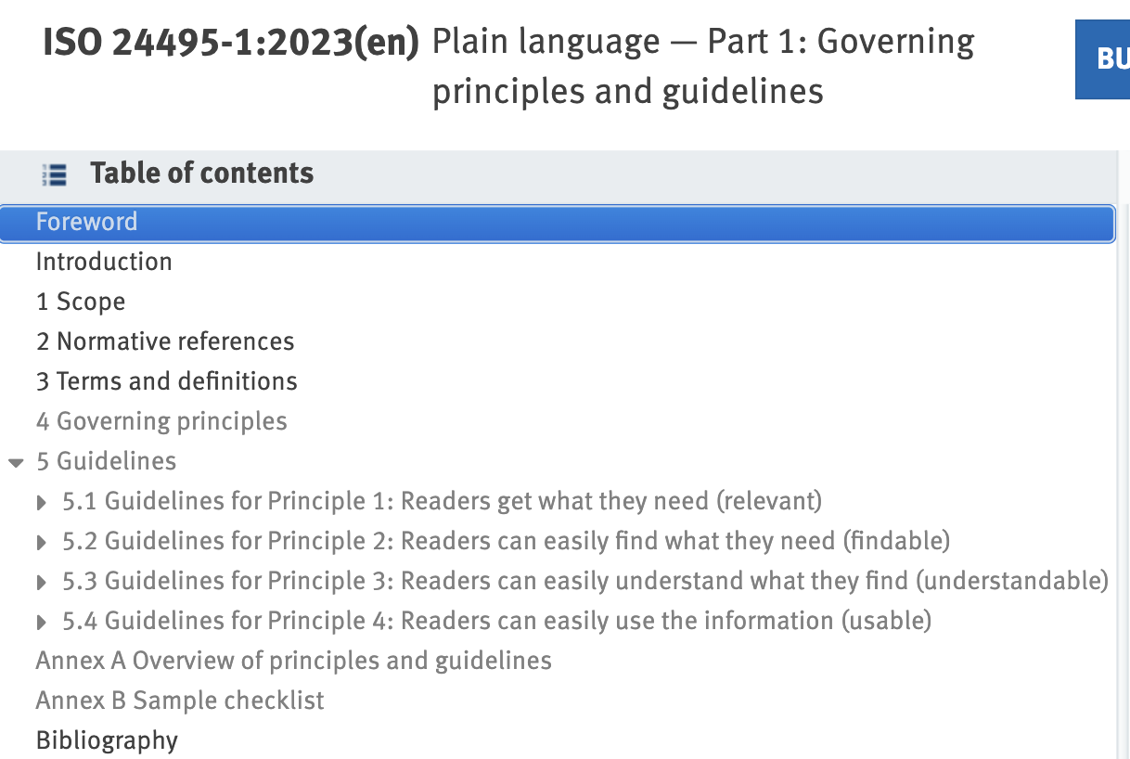
3. What is the standard?

Slide 10
4. How do you use it?
4 Principles
“A communication is in plain language if its wording, structure, and design are so clear that the intended readers can easily find what they need, understand what they find, and use that information.”
Agreed on at Clarity conference, Antwerp, Belgium 2014
Now adopted in 26 languages, see iplfederation.org

Slide 11
Find
Is information structured to fit readers needs?
Does it put the most important information where readers will quickly see it
Is the information sequenced information in a way that will make sense to readers?
Does the information use typography, formatting, and visuals to make it easy for readers to find what they need?
Does the information use effective headings that enable readers to predict content and scan to get the “big picture”?

Slide 13
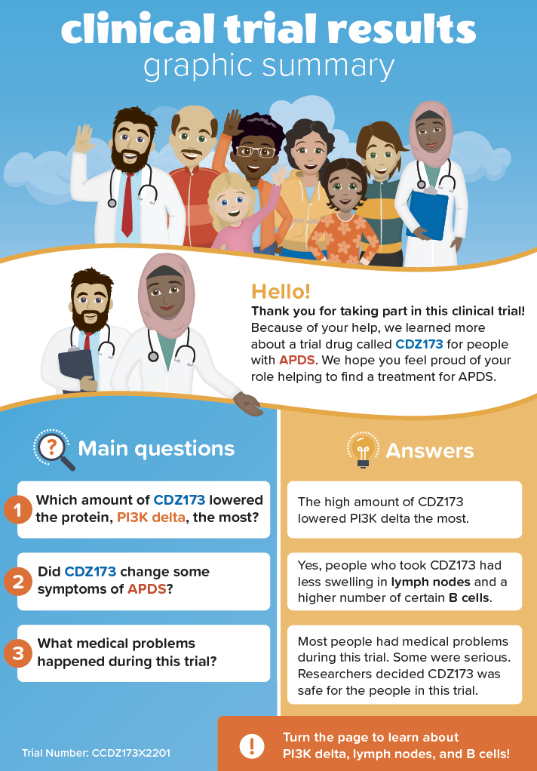

Slide 14
4. How do you use it?
4 Principles
“A communication is in plain language if its wording, structure, and design are so clear that the intended readers can easily find what they need, understand what they find, and use that information.”
Agreed on at Clarity conference, Antwerp, Belgium 2014
Now adopted in 26 languages, see iplfederation.org

Slide 15
Understand
Does the information reflect a thorough understanding of intended readers, including their language skills, cultural backgrounds, and subject-matter knowledge?
Does the entry reflect a thorough understanding of why intended readers should read it, whether they aim to complete a task, make a decision, understand a topic, or achieve some other purpose?
Does the content of the document fit readers’ needs and purpose, addressing the questions readers need answered, omitting irrelevant information?

Slide 16
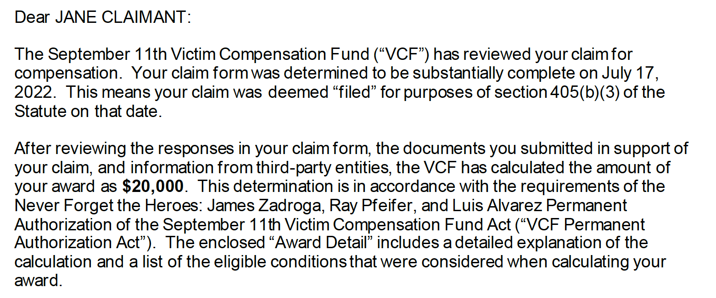

Slide 17
4. How do you use it?
4 Principles
“A communication is in plain language if its wording, structure, and design are so clear that the intended readers can easily find what they need, understand what they find, and use that information.”
Agreed on at Clarity conference, Antwerp, Belgium 2014
Now adopted in 26 languages, see iplfederation.org

Slide 18
Use
Does the information enhance real-world use?
Does the information enable people to live better lives and visualize themselves in the process?
Did the organization evaluate the information for cultural appropriateness?
Did the organization evaluate the entry before publishing or sending it– ideally testing it with users– and revise the entry based on the evaluation results?
Did the organization measure the success of the entry in terms of enabling readers and the organization to achieve their goals?

Slide 19
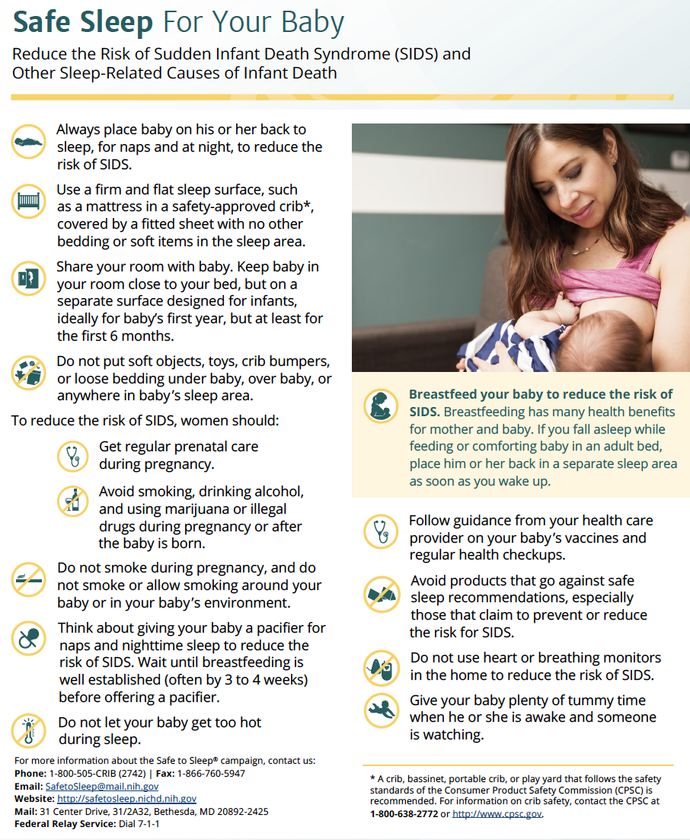
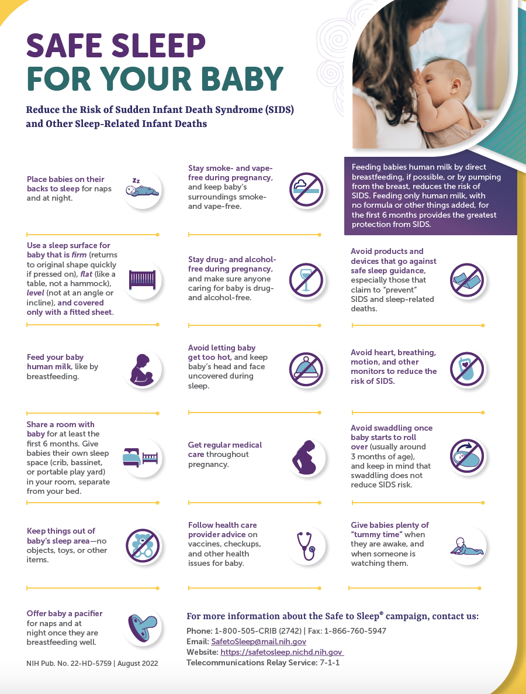

Slide 20
5. What’s next?
Sharing the standard
Is not a style guide.
Works in all languages.
Use for guidance “should” (not mandatory, “shall”).
Adopting the standard
Voluntary for countries to adopt and then to adapt
Voluntary for individuals and organizations

Slide 21
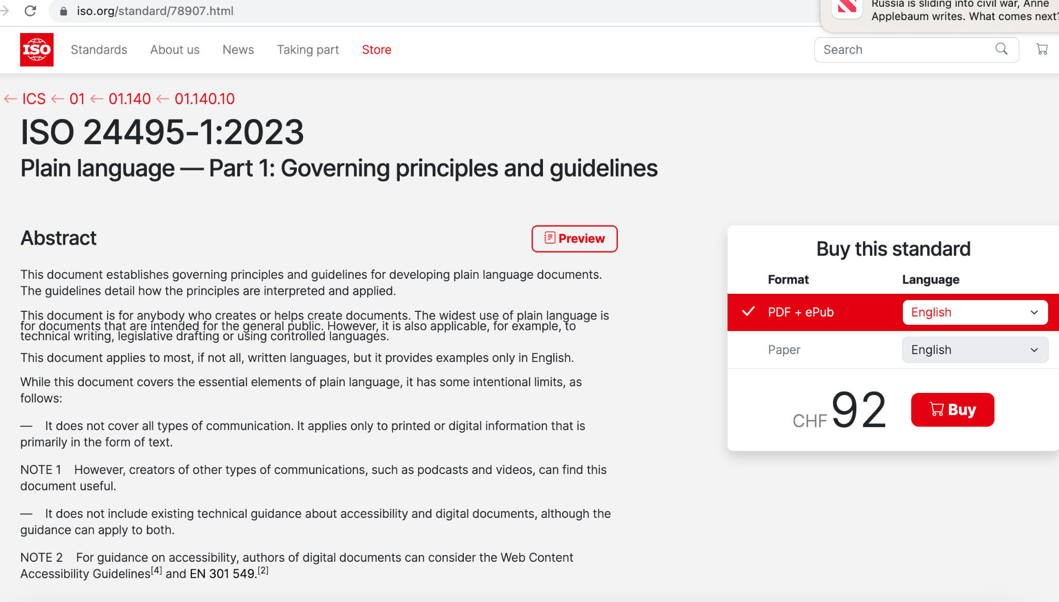
5. What’s next?
Learn more about plain language and become an advocate!
www.centerforplainlanguage.org
Purchase the Standard at www.ISO.org
https://bit.ly/42PqTdA

Slide 22
Questions?
Barbra Kingsley, PhD
Center for Plain Language
Kingsley-Kleimann Group
bkingsley@kingsley-kleimann.com

