Slide 1
Welcome
We will get started soon!

Slide 2
Innovation and Needs-Based Program Paves the Way to Health Equity
Gail Kouame, MLIS
Associate Professor
Assistant Director for Research & Education Services
Robert B. Greenblatt, M.D. Library | Augusta University

Slide 3
Some Definitions
Jail - Short-term facilities usually administered by local law enforcement agencies. Jail inmates usually have a sentence of less than a year or are being held pending a trial, awaiting sentencing, or awaiting transfer to another facility.
Prison - Longer-term facilities owned by a state or by the federal government. Prisons typically hold felons with sentences of more than a year.

Slide 4
Some Definitions
Inmate – an individual in custody in a public institution who is held involuntarily through operation of law enforcement authorities. Incarcerated – serving a term in prison or jail. Justice-involved – anyone who is currently, or has been involved, with the criminal justice system – jail, prison, pre-release, community supervision – pretrial, probation or parole. Returning citizens – removing the stigma of labels like ex-con, ex-offender, criminal, thug.

Slide 5
American Criminal Justice System*
Holds 2 million people in:
1,719 state prisons
109 federal prisons
1,772 juvenile correctional facilities
3,163 local jails
80 Indian Country jails
*Does not include military prisons or immigration detention facilities

Slide 6
9 Million Cycle Through Local Jails Per Year

Slide 7
There’s Probably Someone You Know…
1 in 40 US adults (or 2.5% of US adult population) are under some form of correctional supervision
95% of state prisoners will be released from prison at some point
In a 2018 study, 68% of released state prisoners were arrested within 3 years; 79% within 6 years; 83% within 9 years

Slide 8
Health Disparities Among Incarcerated Populations
A population is a health disparity population if there is a significant disparity in the overall rate of:
Disease incidence
Prevalence
Morbidity
Mortality
Survival rates
in the population as compared to the health status of the general population.

Slide 9
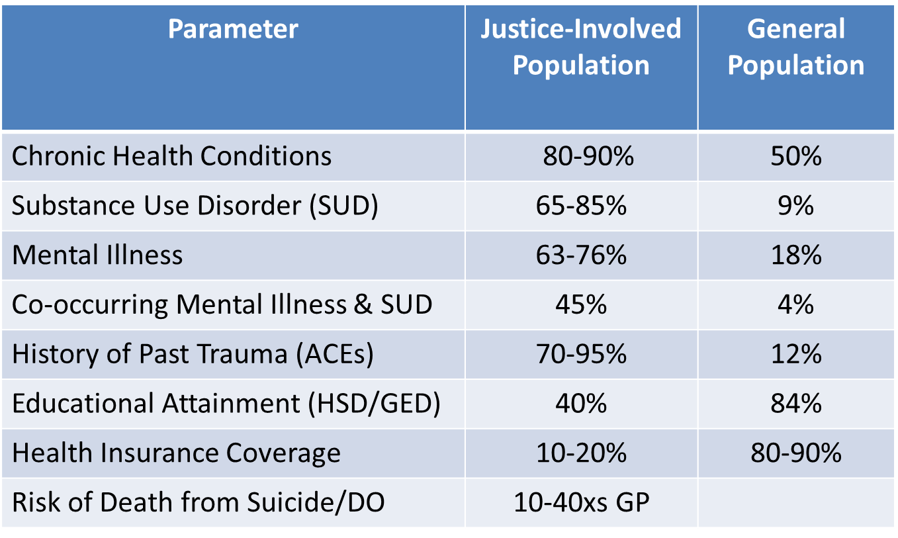
Health Disparities Among Incarcerated Populations

Slide 10
Health Disparities Among Incarcerated Populations
Higher rates of HIV, Hep C, TB, diabetes, asthma and high blood pressure than general population¹
Once released, justice-involved die at 12 times the rate of the general population²
Higher rates of mental health and substance use disorders than other vulnerable high risk populations³
Attributable to limited health literacy, lack of access to health care services, and inability to navigate a complex healthcare system⁴
¹Bai et al. 2015. J Health Care
²Binswanger et al. Correct 2007. NEJM
³Hassan et al. 2014. NIHR Journals Library
⁴Easley, CE (2011). Public Health

Slide 11
Common Chronic Health Conditions
Asthma
Hypertension
Tuberculosis
Diabetes
Hepatitis
HIV/AIDS
Substance Use Disorders & Mental Health Issues

Slide 12
So, What Can Be Done?

Slide 13
The Grant
National Library of Medicine (NLM) | National Institutes of Health (NIH) – Information Resource Grant to Reduce Health Disparities
“…projects that will bring useful, usable health information to health disparity populations and the health care providers who care for those populations…
Proposed projects should exploit the capabilities of computer and information technology and health sciences libraries to bring health-related information to consumers and their health care providers.”
Notes:
$300,000 over 3 years

Slide 14
Aims Of The Study
Specific Aims:
Aim 1: Conduct a health needs assessment to determine the special health information needs and the health coverage eligibility status of justice-involved individuals preparing for reentry into the community;
Aim 2: Deliver comprehensive health information curricula and training modules to justice-involved individuals currently incarcerated at Edovo partner sites;

Slide 15
Aims Of The Study
Specific Aims (cont’d)
Aim 3: Measure the impact that health information training has on the level of health literacy, the confidence to improve self-care management skills, and the interactions with health care providers;
Aim 4: Follow a sample of justice-involved individuals for 6 months after they are released from incarceration to collect post-release outcomes

Slide 16
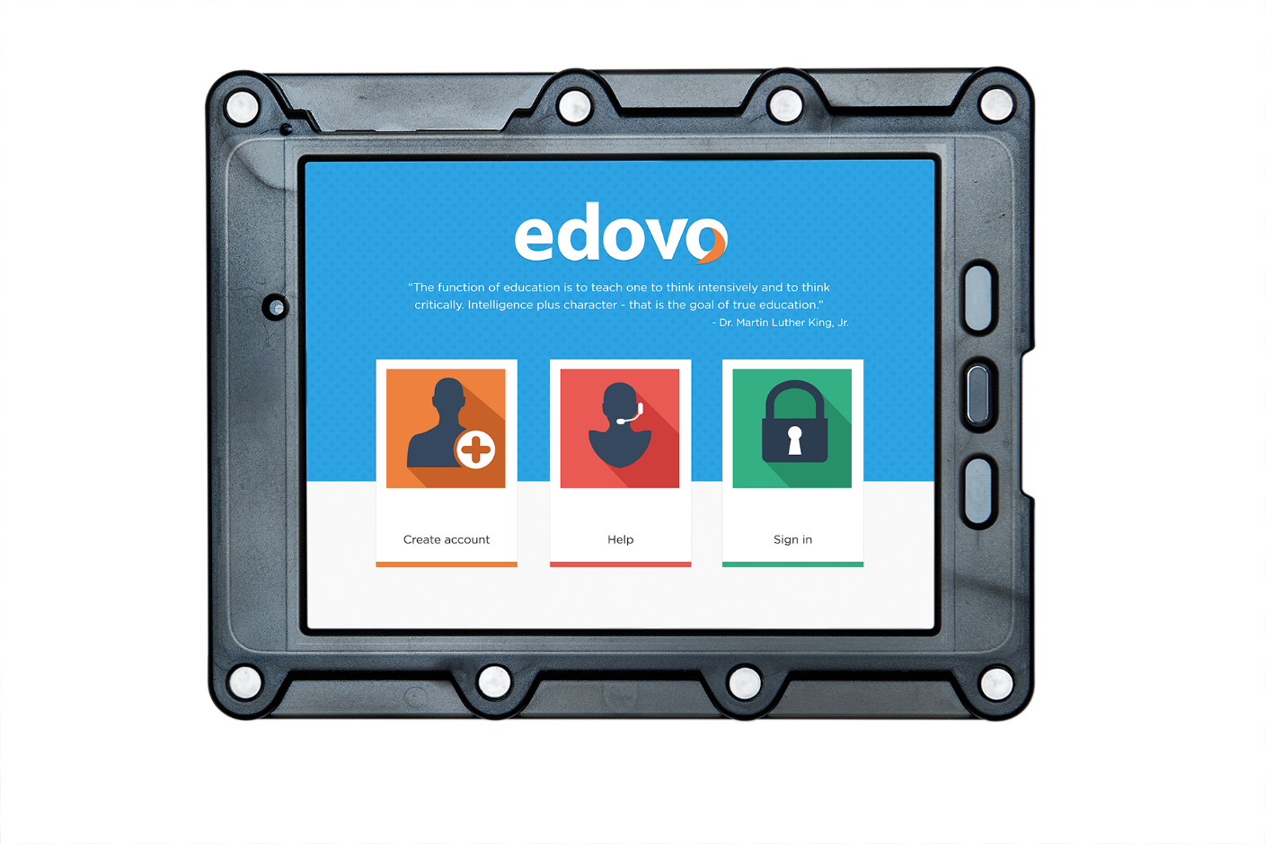
Enter Edovo -Secure Tablet Technology

Slide 17
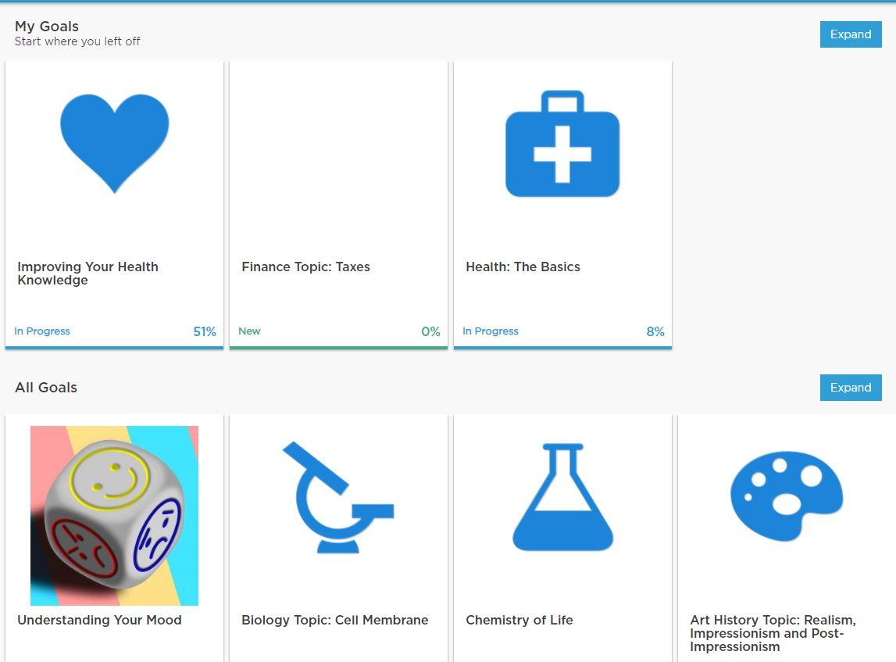
Edovo Educational Content

Slide 18
Health Education Modules - Themes
Health Topic | Health Topic
Advocacy & Self-Care | Nutrition & Physical Activity
Preventive Care | Anxiety & Depression
Addiction & Substance Use | Dental Health
Pain Management | Smoking Cessation
Sexual/Reproductive Health | Medications & Lab Results
Mental Health | Health Insurance
Primarily short videos

Slide 19
Methods
Needs assessment administered via tablets at all Edovo partner facilities nationwide (February 2018)
Research study administered via tablets at ten study participant corrections facilities where Edovo tablets already in place (February 2019 – February 2020)
Study consent provided via video and PDF document linked in tablet
Eligibility: At least 18 years old; between 21 and 180 days remaining of sentence
Notes:
Needs assessment results presented at MLA 2018

Slide 20
Methods
Health education modules grouped as a Goal in the Edovo system
Pre-and post-intervention questionnaires administered via tablets. Reminder messages sent to those who had accessed content but not yet completed questionnaires
Participation incentivized with increments totaling up to $50 loaded onto ClinCards at different stages of the study
Contact information for the project distributed to facilitate post-release follow-up
Notes:
Anyone in the participating correction facilities could access modules, regardless of participation in the study. The modules will remain available indefinitely and the research components (questionnaires, etc) stripped out now that the study has concluded.

Slide 21
Methods
Data about which modules were accessed collected and data dashboards sent to research team weekly
Data from pre- and post-intervention questionnaires collected and managed at Edovo
Raw questionnaire data made accessible to research team for analysis

Slide 22
Three Sets Of Study Questions
Questions to measure health literacy
Questions regarding importance of health behaviors
Questions regarding confidence in performing selected health-related behaviors

Slide 23
Results
Over 3,000 individuals at participating facilities accessed at least one educational module
453 individuals completed the introductory material and the consent
112 individuals completed all phases of the research study
The following data represents the findings from these participants
All questions were optional to answer
9 individuals completed the post-release survey

Slide 24
Results
Majority of participants were male (78%)
Majority of participants were white (54%)
Majority of participants had completed high school (46%); second highest number of participants had completed some college (34%)
Majority of participants were between 35 – 44 years old (36%); second highest number of participants were between 25-24 years old (26%)

Slide 25
Results
Statistically significant overall improvement in all three areas of study from pre-test to post-test (aggregate results in each area)
Improvement in three of seven questions regarding health literacy
Improvement in all nine questions regarding health behaviors
Improvement in all but one question regrading confidence in performing selected health-related behaviors

Slide 26
Correspondence From Participants
“Salutations and thank you for all the opportunities…”
“I really enjoy participating in the ‘Improving Your Health Knowledge…”on the Edovo tablet program. If it was not for people like you, people like me would never have the opportunity to better myself (themselves)…Just because I am never being released, doesn’t mean I don’t want to improve myself. Maybe I can pass on the knowledge to others.”

Slide 27
Conclusions
Providing health education modules paired with self-directed learning via secure tablets computers is an effective method for improving health literacy and self-care management for incarcerated persons
There is not a strong correlation between gender, race, or education level and health literacy or self-care management, based on the findings of this study

Slide 28
Policy Implications – Based on Lessons Learned
There are several tablet providers for corrections facilities – do leg work to determine which is the best fit for your needs
Determine whether or not the Department of Corrections you plan to work with has a contract for tablets and with whom
If you plan to do research with justice-involved participants, the IRB process is more complex – allow plenty of time
The consent process can be a barrier as well

Slide 29
Policy Implications – Based on Lessons Learned
Assure buy-in from participating facilities
Get letters of support and MOUs
Follow-up with people once they are released is challenging
How to communicate
How to stay in touch
They have other more pressing priorities (housing, finding a job, reintegrating into the community)

Slide 30
Question & Answer

Slide 31
Thank you
Gail Kouame, MLIS
gkouame@augusta.edu

